Slide 1
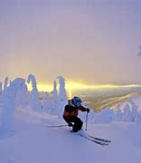
Big Mountain Resort Ticket Pricing Analysis
A Preliminary Analysis

Slide 2
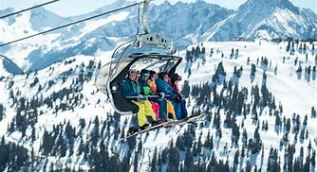
Aims:
Optimize Big Mountain Resort ticket pricing
Assess increase in ticket price to cover new lift op. cost
Evaluate price increase assessment strategies
Evaluate a machine learning model for price prediction
Evaluate several business improvement scenarios
Notes:
© Copyright Showeet.com – Free PowerPoint Templates

Slide 3
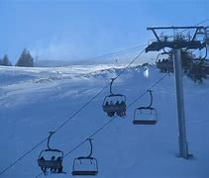
Scenarios
Closing up to 10 least used runs
Adding a run, increasing the vertical drop by 150 feet, and installing an additional chair lift.
Adding 2 acres of snow making in addition to adding a run, increasing the vertical drop by 150 feet, and installing an additional chair lift.
Increasing the longest run by .2 miles and guaranteeing its snow coverage by adding 4 acres of snow making capability.
Notes:
© Copyright Showeet.com – Free PowerPoint Templates

Slide 4
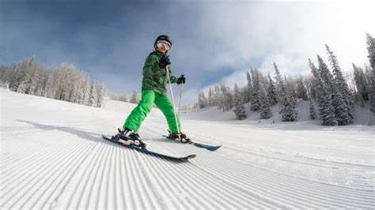
Recommendations
Ongoing use and enhancement of the designed machine learning model to further evaluate price increases
Predicted price range $96 +/- $10, based on important resort features. Current price is $81.
Closing runs correlates negatively with pricing support: 2 runs vs 6 runs
The model predicts adding a run, increasing the vertical drop 150 feet, installing an additional chair lift lends support for $1.99 increase
The model predicts adding 2 acres of snow making, adding a run, increasing the vertical drop by 150 feet, installing an additional chair lift: $1.99 increase
No pricing support for increasing the longest run by .2, adding 4 acres of snow making capability.
Notes:
© Copyright Showeet.com – Free PowerPoint Templates

Slide 5
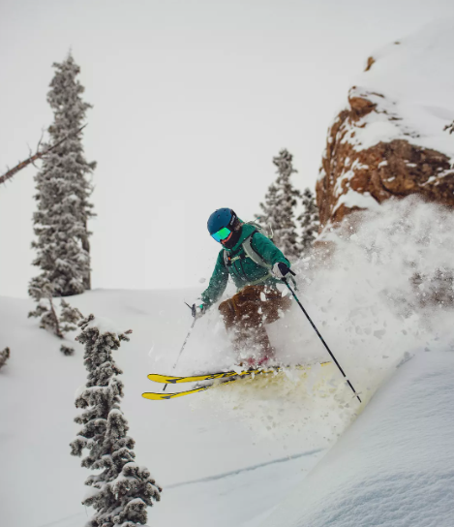
The machine learning model
Random Forest Regression Model
Dataset: Missing results imputation using the median
Cross validation
Hyperparameters
Model future enhancements
Cost data
Market data
Notes:
© Copyright Showeet.com – Free PowerPoint Templates

Slide 6
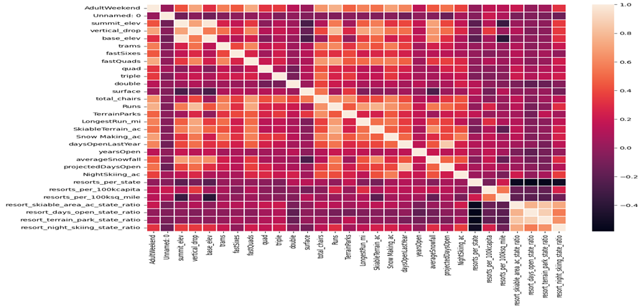
Resort Features Analysis
8 features had high correlation with price
The vertical drop,
the snow making acreage,
the number of total chairs,
the number of fast quads,
the number of runs,
the longest run distance,
the number of trams and
the total skiable terrain acreage.
The latter two had negative coefficients.

Slide 7
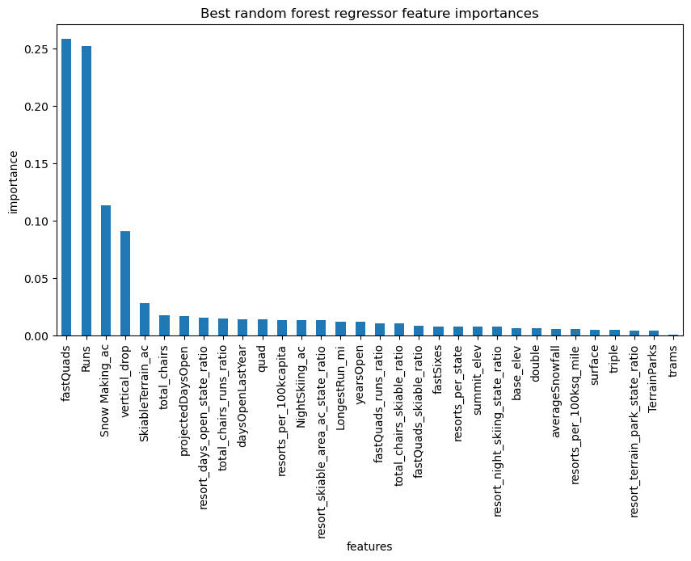
Resort Features Analysis
Out of 8 features, four were selected as most correlated lending ticket price support
The number of fast quads lifts
The number of runs
Snow making acreage
The vertical mountain drop height.

Slide 8
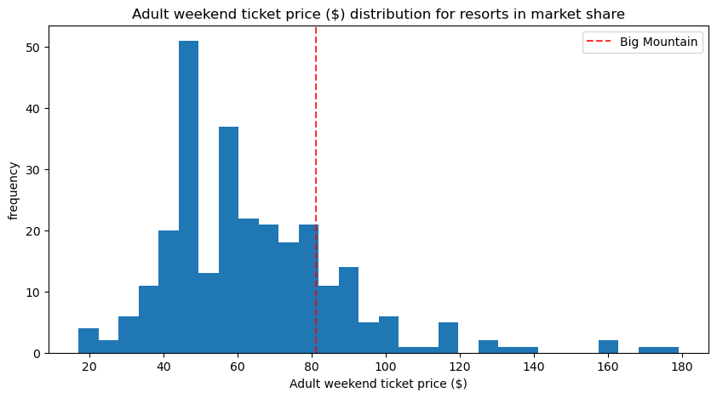
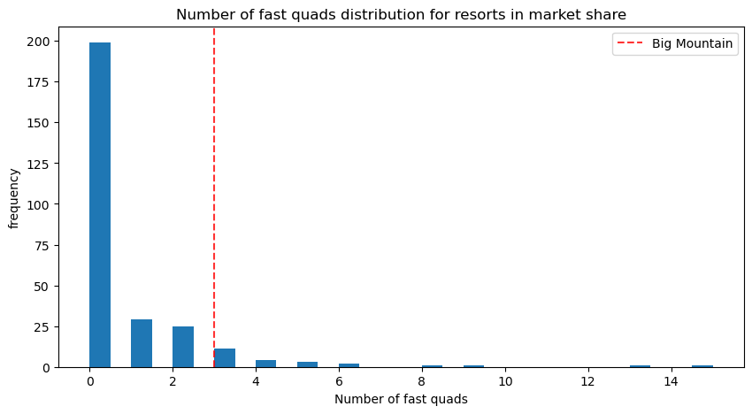
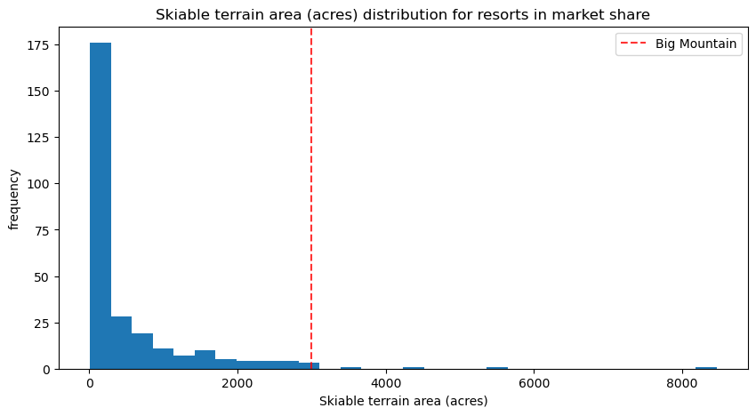
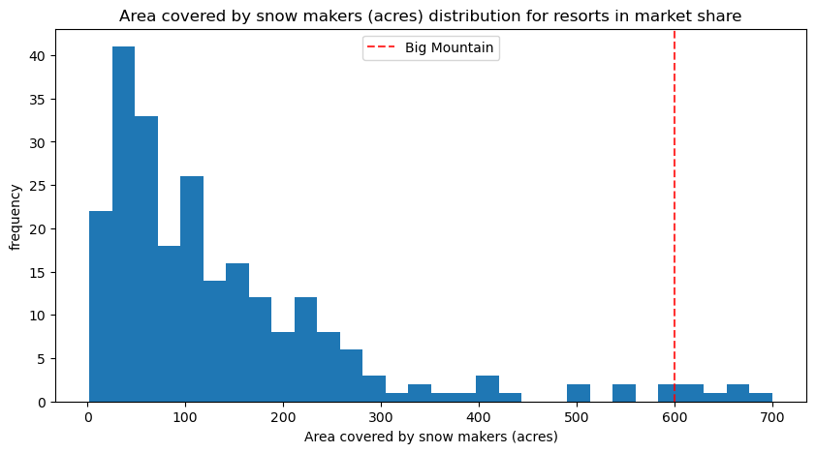
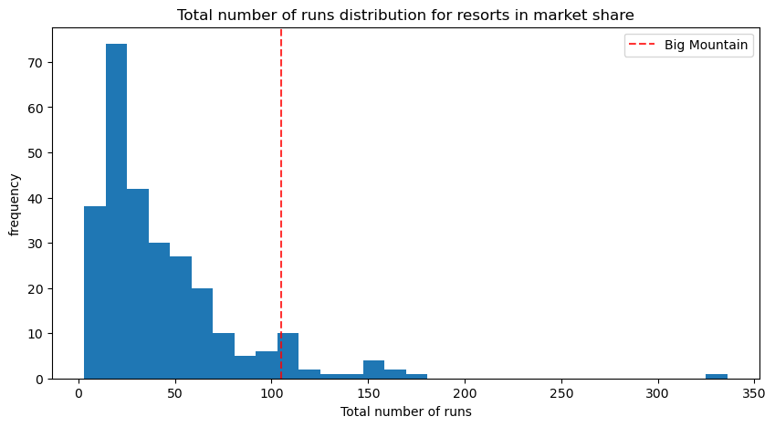
Examples of Feature Analysis
Adult weekend ticket price for Big Mountain Resort is in the higher range of ticket prices
Big Mountain Resort has 3 fast quads placing it in the higher echelon of ski resorts
Total number of runs position: High ranking
Snow Making area: High ranking
Skiable terrain: High ranking
Notes:
© Copyright Showeet.com – Free PowerPoint Templates

Slide 9
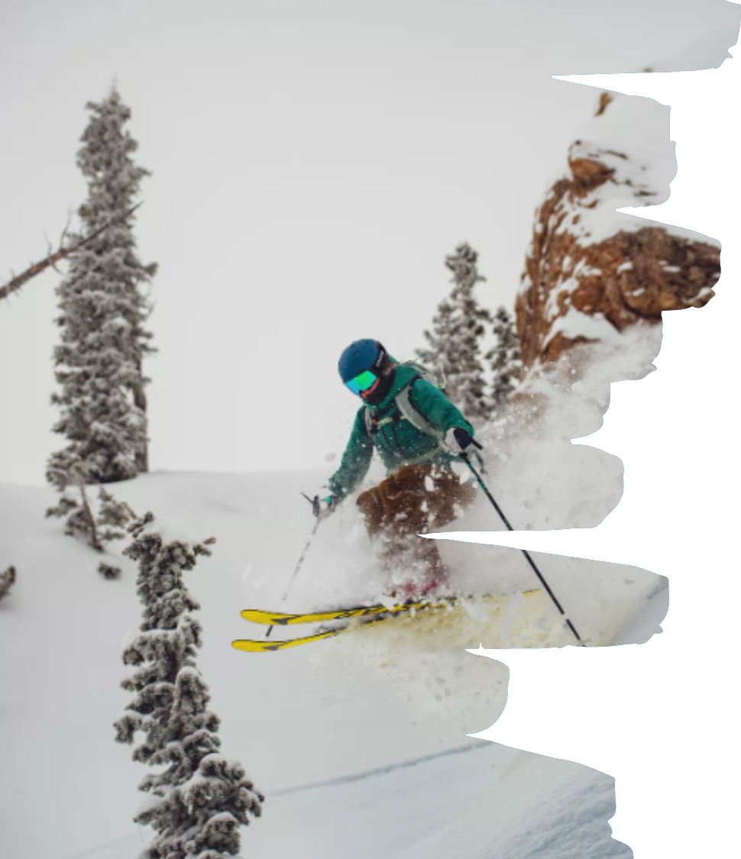
Summary
Big Mountain Resort ticket pricing may be increased based on current features alone and with some of the scenarios analyzed
Current price $81, in the high end for the state market
The model suggests a price of 96 +/- $10 error for current features in the broader market
Covering the operational costs for a season of the new lift would amount to $0.88 per ticket, without additional investments or cost cuts
The model predicts adding a run, increasing the vertical drop 150 feet, installing an additional chair lift lends support for $1.99 increase
The model predicts adding 2 acres of snow making, adding a run, increasing the vertical drop by 150 feet, installing an additional chair lift: $1.99 increase
The model may be enhanced with additional data
Market data of important features to visitors
Costs, both, fixed and variable
Notes:
© Copyright Showeet.com – Free PowerPoint Templates

